Slide 1
Intermediate SQL

Slide 2
Questions
Output of the following Query?
select name, instructor.dept_name, building from instructor, department where instructor.dept_name= department.dept_name;
Output of the following Query?
select dept_name from department
where dept_name like “ab%cd”;
Output of the following Query?
select name from instructor
where salary > 10000 is unknown;

Slide 3
Question
Output of the following Query?
select course_id, semester, year, sec_id, avg (total_cred) from student, takes where student.ID= takes.ID and year = 2017 group by course_id, semester, year, sec_id having count(takes.ID) >= 2;
For each course section offered in 2017, the above query will find the average total credits (tot cred) of all students enrolled in the section, if the section has at least 2 students.

Slide 4
Outline
Join Expressions
Views
Transactions
Integrity Constraints
SQL Data Types and Schemas
Authorization

Slide 5
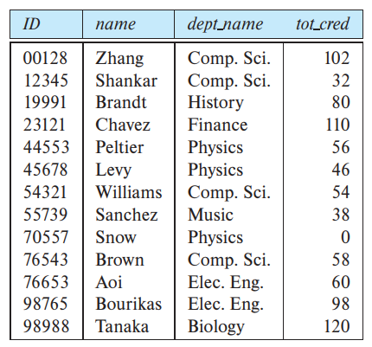
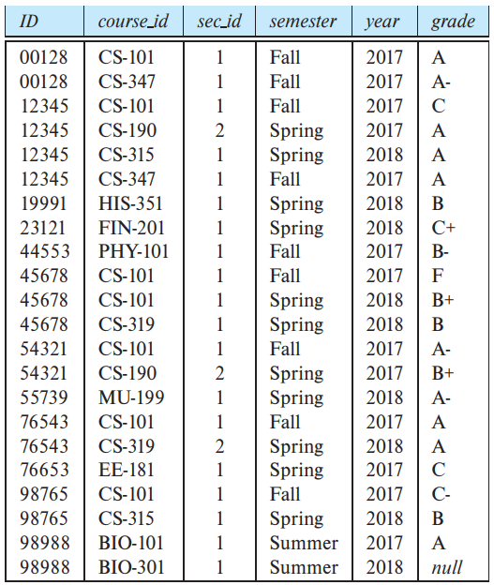
Cartesian Product
student
A Cartesian product is formed when:
A join condition is omitted
A join condition is invalid
All rows in the first table are joined to all rows in the second table
To avoid a Cartesian product, always include a valid join condition in a WHERE clause.
A JOIN clause is used to combine rows from two or more tables, based on a related column between them.
takes

Slide 6
The Natural Join
student
The natural join operation operates on two relations and produces a relation as the result.
Natural join considers only those pairs of tuples with the same value on those attributes that appear in the schemas of both relations.
student natural join takes
considers only those pairs of tuples where both the tuple from student and the tuple from takes have the same value on the common attribute, ID
takes

Slide 7
The Natural Join
student
For all students in the university who have taken some course, find their names and the course ID of all courses they took
Earlier
select name, course_id from student, takes where student.ID = takes.ID;
With Natural Join
select name, course_id from student natural join takes;
takes
replaced by the relation obtained by evaluating the natural join

Slide 8
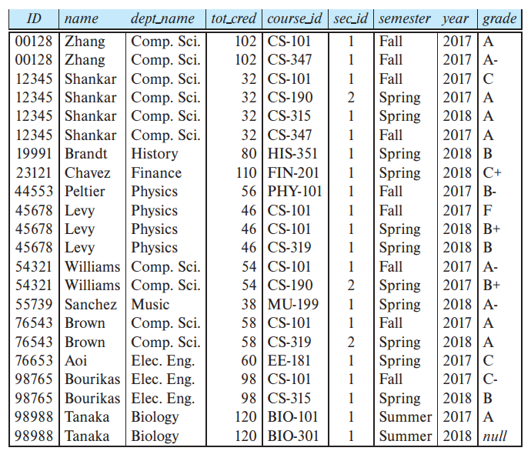
The Natural Join
student
takes

Slide 9
The Natural Join
student
A from clause in an SQL query can have multiple relations combined using natural join:
select A1, A2, … , An
from r1 natural join r2 natural join . . . natural join rm where P;
takes

Slide 10
The Natural Join
student
Question: List the names of students along with the titles of courses that they have taken.
select name, title from student natural join takes, course where takes.course_id = course.course_id;
The natural join of student and takes is first computed and a Cartesian product of this result with course is computed
from which the where clause extracts only those tuples where the course identifier from the join result matches the course identifier from the course relation.
Note that takes.course id in the where clause refers to the course_id field of the natural join result, since this field, in turn, came from the takes relation.
takes

Slide 11
The Natural Join
student
Question: List the names of students along with the titles of courses that they have taken.
select name, title from student natural join takes, course where takes.course_id = course.course_id;
Is the following query will produce same result?
select name, title from student natural join takes natural join course;
takes

Slide 12
The Natural Join
student
select name, title from student natural join takes natural join course;
natural join of student and takes contains the attributes (ID, name, dept_name, tot_cred, course_id, sec_id, semester, year, grade), while the course relation contains the attributes (course_id, title, dept_name, credits).
As a result, the natural join would require that the dept name attribute values from the two relations be the same in addition to requiring that the course id values be the same.
This query would then omit all (student name, course title) pairs where the student takes a course in a department other than the student’s own department.
takes

Slide 13
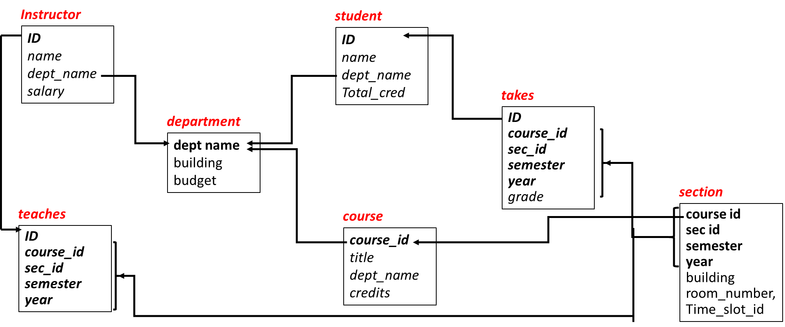
Join … using
Form of natural join that requires values to match only on specified attributes
select name, title
from (student natural join takes)
join course using (course_id);
Question: List the names of students along with the titles of courses that they have taken.
student natural join takes
student natural join takes natural join course

Slide 14
Questions
Output of the following Query? Assume, Primary key constraint is absent.
insert into student select * from student;
Output of the following Query?
select name from instructor
where salary > 10000 is unknown;
Output of the following Query?
update instructor set salary = salary * 1.03 where salary > 100000;

Slide 15
Join Conditions: ON Conditions
Defines which tuples in the two relations match, and what attributes are present in the result of the join.
ON condition
Allows a general predicate over the relations being joined
Example
select * from student join takes on student.ID = takes.ID;
IS the following query will return different result?
select * from student natural join takes
Yes, The one difference is that the result has the ID attribute listed twice in the first query

Slide 16
Join Conditions: ON Conditions
Defines which tuples in the two relations match, and what attributes are present in the result of the join.
ON condition
Allows a general predicate over the relations being joined
Example
select * from student join takes on student.ID = takes.ID;
IS the following query will return different result?
select student.ID as ID, name, dept name, tot cred,
course id, sec id, semester, year, grade
from student join takes on student.ID = takes.ID;
NO?

Slide 17
Outer Joins
student
Display a list of all students, displaying their ID, and name, dept_name, and tot_cred, along with the courses (course_id’s) that they have taken.
select * from student natural join takes;
Will the above query work?
No, suppose that there is some student who takes no courses.
The outer-join operation works in a manner similar to the join operations, but it preserves those tuples that would be lost in a join by creating tuples in the result containing null values
takes

Slide 18
Outer Joins
student
There are three forms of outer join:
The left outer join preserves tuples only in the relation named before (to the left of) the left outer join operation.
The right outer join preserves tuples only in the relation named after (to the right of) the right outer join operation.
The full outer join preserves tuples in both relations
The join operations we studied earlier that do not preserve nonmatched tuples are called inner-join operations
takes

Slide 19
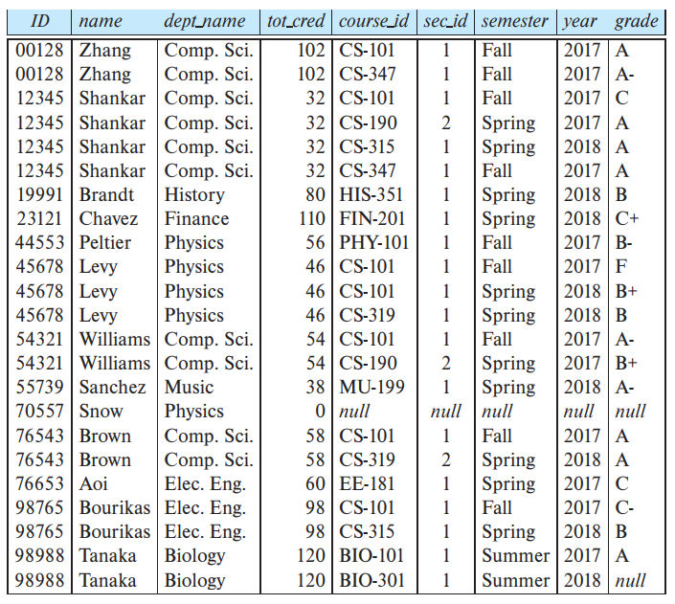
Outer Joins
student
left outer join
Select * from student natural left outer join takes;
takes

Slide 20
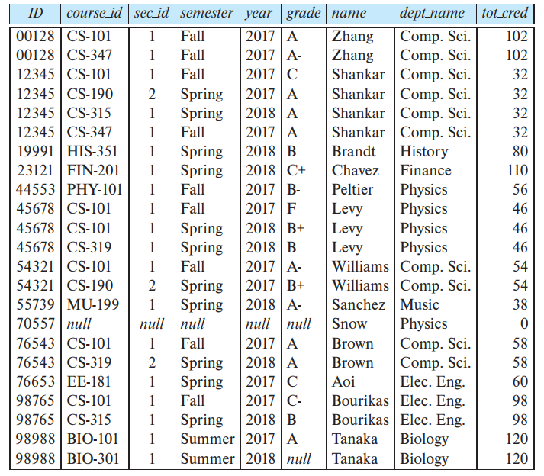
Outer Joins
student
right outer join
The right outer join is symmetric to the left outer join
Select * from takes natural right outer join student;
takes

Slide 21
Outer Joins
student
full outer join
The full outer join is a combination of the left and right outer-join types.
Note that the full-outer join is not supported by MySQL
you can emulate one by combining left and right-outer join with UNION set operation.
takes

Slide 22
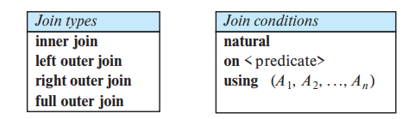
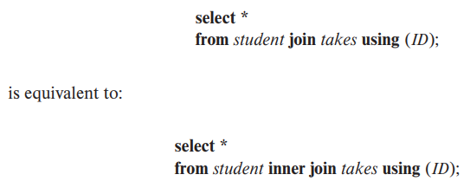
Join Types and Conditions
To distinguish normal joins from outer joins, normal joins are called inner joins in SQL.
A join clause can thus specify inner join instead of outer join.
The keyword inner is, however, optional.
Similarly, natural join is equivalent to natural inner join.

Slide 23
Views
In some cases, it is not desirable for all users to see the entire logical model.
Consider a person who needs to know the instructors name and department, but not the salary. This person should see a relation described, in SQL, by
select ID, name, dept_name from instructor
A view provides a mechanism to hide certain data from the view of certain users.
Any relation that is not of the conceptual model but is made visible to a user as a “virtual relation” is called a view.

Slide 24
View Definition
A view is defined using the create view statement which has the form
create view view_name as <query expression>
where <query expression> is any legal SQL expression. The view name is represented by view_name.
A view definition causes the saving of an expression; the expression is substituted into queries using the view.

Slide 25
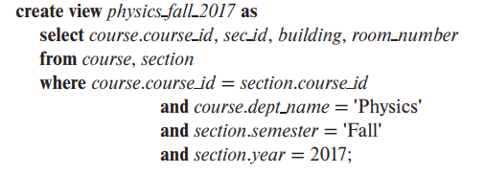
Views
Create a view that lists all course sections offered by the Physics department in the Fall 2017 semester with the building and room number of each section

Slide 26
Views Defined Using Other Views
create view physics_fall_2017 as select course.course_id, sec_id, building, room_number from course, section where course.course_id = section.course_id and course.dept_name = ’Physics’ and section.semester = ’Fall’ and section.year = ’2009’;
create view physics_fall_2009_watson as select course_id, room_number from physics_fall_2017 where building= ’Watson’;

Slide 27
Materialized Views
Certain database systems allow view relations to be stored, but they make sure that, if the actual relations used in the view definition change, the view is kept up-to-date. Such views are called materialized views.
materialized views allow query to potentially run much faster by using the precomputed view result, instead of recomputing it.

Slide 28
Update of a View
Although views are a useful tool for queries, they present serious problems if we express updates, insertions, or deletions with them.
Perfectly fine if you have view like
create view faculty as select ID, name, dept_name from instructor;
What about
insert into faculty values ('30765', 'Green', 'Music’); ?
This insertion must be represented by an insertion into the relation instructor, since instructor is the actual relation from which the database system constructs the view faculty.
However, to insert a tuple into instructor, we must have some value for salary.

Slide 29
Update of a View
What about
insert into faculty values ('30765', 'Green', 'Music’); ?
This insertion must be represented by an insertion into the relation instructor.
However, to insert a tuple into instructor, we must have some value for salary.
Approaches to dealing with this insertion
Reject the insertion, and return an error message to the user
Insert a tuple ('30765', 'Green', 'Music', null) into the instructor relation.

Slide 30
Update of a View
Some Updates cannot be Translate Uniquely create view instructor_info as select ID, name, building from instructor, department where instructor.dept_name= department.dept_name; insert into instructor_info values (’69987’, ’White’, ’Taylor’);
Suppose there is no instructor with ID 69987, and no department in the Taylor building.
Then the only possible method of inserting tuples into the instructor and department relations is to
insert ('69987', 'White', null, null) into instructor and
(null, 'Taylor', null) into department.
Instructor
ID
name dept_name
salary
department
dept name
building budget

Slide 31
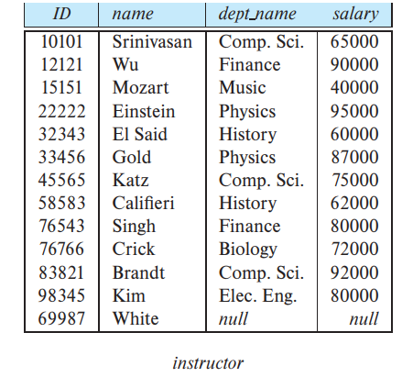
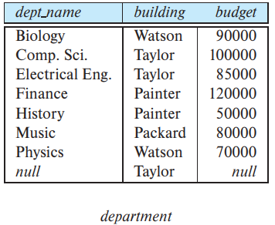
Update of a View
Then the only possible method of inserting tuples into the instructor and department relations is to
insert ('69987', 'White', null, null) into instructor and
(null, 'Taylor', null) into department.
Instructor
ID
name dept_name
salary
department
dept name
building budget

Slide 32
Update of a View
Then the only possible method of inserting tuples into the instructor and department relations is to
insert ('69987', 'White', null, null) into instructor and
(null, 'Taylor', null) into department.
This update does not have the desired effect, since the view relation instructor info still does not include the tuple ('69987', 'White', 'Taylor’).
Thus, there is no way to update the relations instructor and department by using nulls to get the desired update on instructor info
Instructor
ID
name dept_name
salary
department
dept name
building budget

Slide 33
Updatable View
In SQL, view is said to be updatable (i.e., inserts, updates, or deletes can be applied on the view) if the following conditions are all satisfied by the query defining the view:
The from clause has only one database relation.
The select clause contains only attribute names of the relation, and does not have any expressions, aggregates, or distinct specification.
Any attribute not listed in the select clause can be set to null
The query does not have a group by or having clause.

Slide 34
Transactions
A transaction consists of a sequence of query and/or update statements.
Atomic: Either all the effects of the transaction are reflected in the database or none are (after rollback).
Transactions begin implicitly when an SQL statement is executed.
Ended by commit work or rollback work
Commit work makes the updates performed by the transaction become permanent in the database.
Rollback work undoes all the updates performed by the SQL statements in the transaction.
The keyword work is optional in both the statements

Slide 35
Transactions
In many SQL implementations, by default each SQL statement is taken to be a transaction on its own, and it gets committed as soon as it is executed.
Such automatic commit of individual SQL statements must be turned off if a transaction consisting of multiple SQL statements needs to be executed.
A better alternative, which is part of the SQL:1999 standard is to allow multiple SQL statements to be enclosed between the keywords begin atomic … end.

Slide 36
Integrity Constraints (ICs)
Integrity constraints are a set of rules.
ensure that the data insertion, updating, and other processes have to be performed in such a way that data integrity is not affected.
Examples
An instructor name cannot be null.
No two instructors can have the same instructor ID.
Every department name in the course relation must have a matching department name in the department relation.
The budget of a department must be greater than $0.00.
Notes:
5

Slide 37
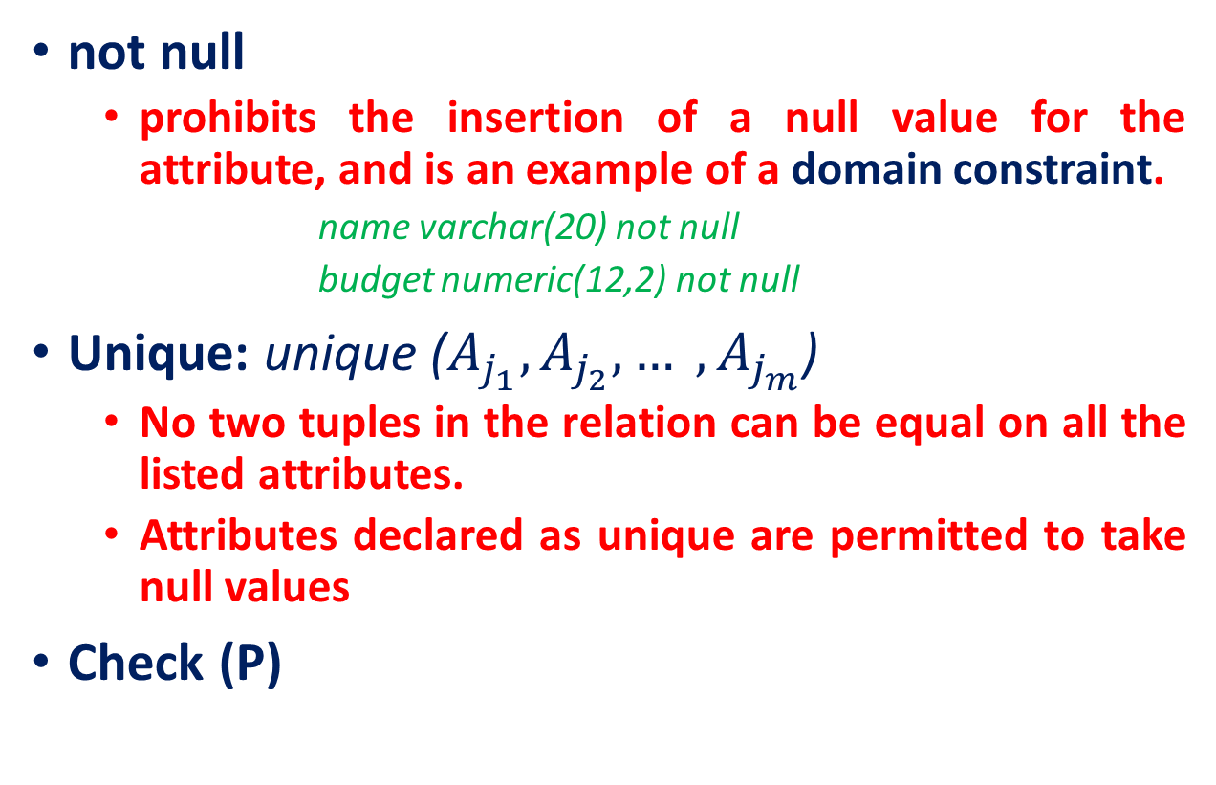
Constraints on a Single Relation
not null
prohibits the insertion of a null value for the attribute, and is an example of a domain constraint.
name varchar(20) not null
budget numeric(12,2) not null
Unique: unique ($A_{j_{1}}, A_{j_{2}}, … , A_{j_{m}}$)
No two tuples in the relation can be equal on all the listed attributes.
Attributes declared as unique are permitted to take null values
Check (P)

Slide 38
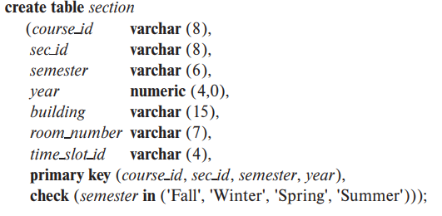
Constraints on a Single Relation
Check (P)
specifies a predicate P that must be satisfied by every tuple in a relation.

Slide 39
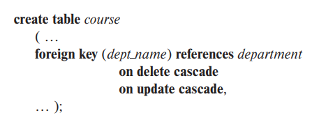
Referential Integrity
Ensure that a value that appears in one relation (the referencing relation) for a given set of attributes also appears for a certain set of attributes in another relation (the referenced relation).
Skipping as already discussed in details

Slide 40

Assigning Names to Constraints
Useful if we want to drop a constraint that was defined previously.

Slide 41
Complex Check Conditions
If a database implementation supports subqueries in the check clause
check (time_slot_id in (select time_slot_id from time_slot))
Question: Why not use a foreign key here?

Slide 42
Assertions
An assertion is a predicate expressing a condition that we wish the database always to satisfy.
When an assertion is created, the system tests it for validity.
If the assertion is valid, then any future modification to the database is allowed only if it does not cause that assertion to be violated.
Example
For each tuple in the student relation, the value of the attribute tot cred must equal the sum of credits of courses that the student has completed successfully.
An instructor cannot teach in two different classrooms in a semester in the same time slot
create assertion <assertion-name> check <predicate>
not supported by most of the RDBMS

Slide 43
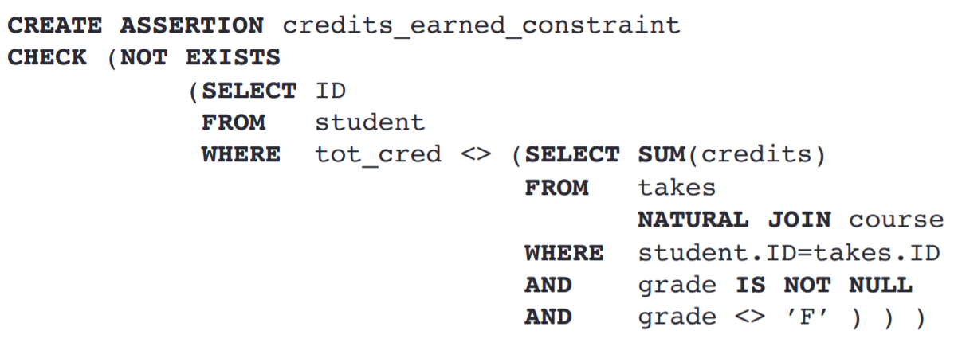
Assertions
For each tuple in the student relation, the value of the attribute tot_cred must equal the sum of credits of courses that the student has completed successfully.

Slide 44
Built-in Data Types in SQL
date: Dates, containing a (4 digit) year, month and date
Example: date ‘2005-7-27’
time: Time of day, in hours, minutes and seconds.
Example: time ‘09:00:30’ time ‘09:00:30.75’
timestamp: date plus time of day
Example: timestamp ‘2005-7-27 09:00:30.75’

Slide 45

Type Conversion and Formatting Functions
Although systems perform some data type conversions automatically, others need to be requested explicitly.
cast (e as t): convert an expression e to the type t.
MySQL offers a format function. Oracle and PostgreSQL offer a set of functions, to_char, to_number, and to_date. SQL Server offers a convert function.

Slide 46
Type Conversion and Formatting Functions
We can choose how null values are output in a query result using the coalesce function.
For example, if we wished to display instructor IDs and salaries but to show null salaries as 0, we would write:
select ID, coalesce(salary, 0) as salary
from instructor
A limitation of coalesce is the requirement that all the arguments must be of the same type.
If we had wanted null salaries to appear as 'N/A' to indicate “not available”, we would not be able to use coalesce.

Slide 47
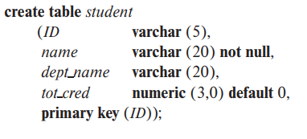

Default Values
SQL allows a default value to be specified for an attribute

Slide 48

Large-Object Types
Many database applications need to store attributes whose domain consists of large data items such as a photo, a high-resolution medical image, or a video.
character data (clob) and binary data (blob)

Slide 49

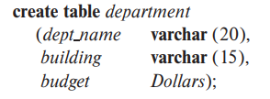
User-Defined Types
create type construct in SQL creates user-defined type
FINAL indicate that this method cannot be overridden by any subtype of this type.

Slide 50
Create Table Extensions
create table like extension creation of tables that have the same schema as an existing table
create table temp_instructor like instructor;

Slide 51
Index Creation
create table student
(ID varchar (5),
name varchar (20) not null,
dept_name varchar (20),
tot_cred numeric (3,0) default 0,
primary key (ID))
create index studentID_index on student(ID)
Indices are data structures used to speed up access to records with specified values for index attributes
e.g. select * from student where ID = ‘12345’ can be executed by using the index to find the required record, without looking at all records of student

Slide 52
Authorization
Authorizations on data include:
Read - allows reading, but not modification of data.
Insert - allows insertion of new data, but not modification of existing data.
Update - allows modification, but not deletion of data.
Delete - allows deletion of data
Each of these types of authorizations is called a privilege.
We may authorize the user all, none, or a combination of these types of privileges on specified parts of a database, such as a relation or a view.

Slide 53
Authorization
User submits a query or an update
The SQL implementation first checks if the query or update is authorized based on the authorizations that the user has been granted.
If the query or update is not authorized, it is rejected

Slide 54
Authorization
In addition to authorizations on data, users may also be granted authorization to modify the database schema
Index - allows creation and deletion of indices.
Resources - allows creation of new relations.
Alteration - allows addition or deletion of attributes in a relation.
Drop - allows deletion of relations.

Slide 55
Granting and Revoking of Privileges
The SQL standard includes the privileges select, insert, update, and delete.
A user who creates a new relation is given all privileges on that relation automatically
The grant statement is used to confer authorization
grant <privilege list>
on <relation name or view name>
to <user/role list>;
Select Authorization
The select authorization on a relation is required to read tuples in the relation.
Example
grant select on department to Amit, Satoshi;

Slide 56
Granting and Revoking of Privileges
grant <privilege list>
on <relation name or view name>
to <user/role list>;
Update Authorization
The ability to update using the SQL update statement
The update authorization may be given either on all attributes of the relation or on only some.
Example
grant update (budget) on department to Amit, Satoshi;

Slide 57
Granting and Revoking of Privileges
grant <privilege list>
on <relation name or view name>
to <user/role list>;
Insert Authorization
The insert authorization on a relation allows a user to insert tuples into the relation.
The insert privilege may also specify a list of attributes
Any inserts to the relation must specify only these attributes, and the system either gives each of the remaining attributes default values (if a default is defined for the attribute) or sets them to null
Example
grant insert (id, name, dept_name) on instructor to Amit, Satoshi;

Slide 58
Granting and Revoking of Privileges
grant <privilege list>
on <relation name or view name>
to <user/role list>;
Delete Authorization
The delete authorization on a relation allows a user to delete tuples from a relation.
Example
grant delete on instructor to Amit, Satoshi;
all privileges
used as a short form for all the allowable privileges
The user name public refers to all current and future users of the system. Thus, privileges granted to public are implicitly granted to all current and future users.

Slide 59
Granting and Revoking of Privileges
The revoke statement is used to revoke authorization
revoke <privilege list>
on <relation name or view name>
from <user/role list>;
Example
revoke select on department from Amit, Satoshi;
revoke update (budget) on department from Amit, Satoshi

Slide 60
Roles
Consider the real-world roles of various people in a university.
Each instructor must have the same types of authorizations on the same set of relations.
Whenever a new instructor is appointed, she will have to be given all these authorizations individually.
A better approach would be to specify the authorizations that every instructor is to be given, and to identify separately which database users are instructors.
The notion of roles captures this concept.
In our university database, examples of roles could include instructor, teaching assistant, student, dean, and department_chair.

Slide 61
Roles
Roles can be created in SQL as
create role instructor
Roles can then be granted privileges as
grant select on takes
to instructor;
Chain of roles
create role dean;
grant instructor to dean;
grant dean to Satoshi;

Slide 62
Authorization on Views
Consider a staff member who needs to know the salaries of all faculty in a particular department, say the Geology department.
create view geo_instructor as
(select *
from instructor
where dept name = 'Geology’);

Slide 63
Authorization on Views
Suppose that the staff member issues the following SQL query:
select *
from geo_instructor;
The query processor translates it into a query on the actual relations in the database.
It replaces uses of a view by the definition of the view, producing a query on instructor.
Thus, the system must check authorization on the clerk’s query before it replaces views by their definitions.

Slide 64
Authorization on Views
A user who creates a view does not necessarily receive all privileges on that view.
A user receives only those privileges that provide no additional authorization beyond those that he already had.

Slide 65
Authorizations on Schema
Creating or deleting relations, adding or dropping attributes of relations, and adding or dropping indices.

Slide 66
Other Authorization Features
References privilege to create foreign key
grant reference (dept_name) on department to
Amit;
Why is this required?
There will be many users of the database
What if some other user perform delete or update on the referenced relation?
Thus, the definition of a foreign key by Amit restricts future activity by other users; therefore, there is a need for the references privilege.

Slide 67
Transfer of Privileges
A user who has been granted some form of authorization may be allowed to pass on this authorization to other users.
By default, transfer of privilege is not authorized
For example, if we wish to allow Amit the select privilege on department and allow Amit to grant this privilege to others, we write:
grant select on department to Amit with grant option;

Slide 68
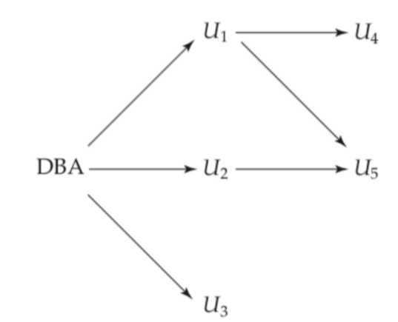
Transfer of Privileges
The passing of a specific authorization from one user to another can be represented by an authorization graph.
The nodes of this graph are the users.
A user has an authorization if and only if there is a path from the root of the authorization graph down to the node representing the user
Assume DBA has given update privilege to U1, U2 and U3 on relation teaches

Slide 69
Revoking of Privileges
Suppose that the database administrator decides to revoke the authorization of user U1
What will happen to U5?

Slide 70
Revoking of Privileges
You can also see that U1 is also getting privilege from U4.
Suppose that the database administrator decides to revoke the authorization of user U1?
Will the privilege will be revoked?

Slide 71
Revoking of Privileges
revocation of a privilege from a user/role may cause other users/roles also to lose that privilege.
This behavior is called cascading revocation and in most database systems, this is default behavior.
The revoke statement may specify restrict in order to prevent cascading revocation:
revoke select on department from Amit, Satoshi restrict;

Slide 72
Revoking of Privileges
revoke grant option for select on department from Amit;
The above query will only revoke the grant option, rather than the actual select privilege:

Slide 73
References
Abraham Silberschatz, Henry F. Korth, and S. Sudarshan, Database System Concepts, 7/e
Adhsakkdi Y, Raghuram Krishnan and Johannes Gehrke, Database Management Systems, 3/e, TMH, 2007.
Some of the figures and Examples are taken from various online sources.

